Slide 1
2017 Performance Management Changes

Slide 2
Program Overview

Slide 3
Program Goals
Make process clearer and less cumbersome
Streamline/target content of performance plan
Use of electronic system
Create standardization for evaluations
Define satisfactory level of work at “meeting expectations” for business needs
Tie institutional goals to mission and vision of the University.

Slide 4
Program Goals
Increase accuracy and defensibility of ratings
Address both behavior and conduct
Ensure position/performance management consistency
Ensure ease of quality control and data analysis
Promote open and clear communication

Slide 5
Evaluation Program – Current & Future
Timelines | Current (through March 31, 2017) | Future (Beginning April 1, 2017)
Performance Cycle | April 1 – March 31 | No change
Performance Planning (Goal Setting & Calibration) | March - April | March – April (with Calibration)
Post-Evaluation Rating Calibration | N/A | March – April
Evaluations Completed | April - May | No Change

Slide 6
Evaluation Program – Current & Future
Evaluation Structure | Current (through March 31, 2017) | Future (Beginning April 1, 2017)
 | Core Work Values | 5 Institutional Goals One additional for supervisors Weighted 50%
 | Job Duties | 3-5 Individual Goals Set by supervisors Weighted 50%
 | Professional Development | Talent Development Goal

Slide 7
Evaluation Program – Current and Future
Types of Evaluations | Current (through March 31, 2017) | Future (beginning April 1, 2017)
Probationary | Due at 3 months | Due Quarterly (January, April, July, October)
Interim | Due October - November | Required if employee has Disciplinary Action, is Not Meeting Expectations, if supervisor wants to, or if Chancellor/designee requires
Transfer | Due at time of Transfer | Due at time of Transfer or if supervisor leaves
Employee Requested Evaluations | N/A | Employees can request one off-cycle evaluation per performance cycle granted 60 days has passed since last evaluation
Management Driven | N/A | Supervisors can conduct as often as they find necessary.

Slide 8
Evaluation Program – Current & Future
 | Current (through March 31, 2017) | Future (beginning April 1, 2017)
Rating | Five-Point System Outstanding Exceeds Expectations Meets Expectations Below Expectations Unsatisfactory | Three-Point System Exceeds Expectations Meets Expectations Below Expectations
 | Final Ratings based on overall evaluation | Final ratings based on weighting and final outcome
Comments | Supervisors comment on each individual Core Work Value and Overall Performance | One overall comments section
 | Employees can include written comments | No change

Slide 9
Evaluation Program
Calibration Sessions
Supervisory teams meet at beginning of cycle to set performance goals
Supervisory teams meet at end of cycle to ensure consistency in performance ratings
Required for Employees in Similar Positions
Best practice for other positions

Slide 10
Evaluation Program
Employee Records
Retain documents for at least 3 years
Hiring supervisors can review performance documents for final candidates
Appeal Rights
Final Overall Rating of “Not Meeting Expectations”
Grievable to University level
University SHRA Employee Grievance Policy

Slide 11
Institutional Goals

Slide 12
Institutional Goals
EXPERTISE
Precision
Resourcing
Innovation
Development
CUSTOMER-ORIENTED
Clarity
Awareness
Attentiveness
Diplomacy
COMPLIANCE/ETHICS
Policy
Safety
Ethics
Respect
ACCOUNTABILITY
Productivity
Autonomy
Prioritization
Coordination
TEAM-ORIENTED
Collegiality
Collaboration
Contribution
Attendance
SUPERVISION
Oversight
Goal-Setting
Managing Talent
Leading

Slide 13
Individual Goals

Slide 14
Individual Goals
Working with employee, supervisor defines 3-5 individual goals for each employee each cycle.
Not intended to cover all aspects of employee work product (institutional goals do that).
Focus is on key results/outcomes/deliverables, not steps in the process.

Slide 15
Smart-er Goals
S - Specific
M - Measurable
A - Achievable
R - Relevant
T - Time-bound
E - Expectations
R - Resources

Slide 16
Individual Goals
Do this…. Present the new Performance Management plan to all SHRA supervisors
in order to…. provide sufficient guidance to supervisors on new program
so that…. they will be ready to develop performance plans in 2017.

Slide 17
Structure of Goals
Three things to keep in mind while preparing SMART-ER goals:
1. The Goal Itself
2. The Specific Deliverables
3. What “Exceeding Expectations” Looks Like.

Slide 18
Structure of Individual Goals
Goal: Present the new PM plan to all SHRA supervisors before December 15, 2016 in order to provide sufficient guidance to supervisors on new program so that they will be ready to develop performance plans in 2017.
Specific Deliverables: 1. Develop a PowerPoint presentation to be used by all involved. 2. Determine what handout materials are needed.
Exceeding Expectations: Not only present new PM plan to all supervisors face-to-face but develop online Cornerstone training based off of face-to-face presentation material as well.

Slide 19
Talent Development

Slide 20
Talent Development
Recommended (not required) that each employee have at least ONE Talent Development Goal per cycle.
Supervisor and employee work to determine appropriate goals
Supervisor expected to address deficiencies of any employee who received any rating of “Not Meeting Expectations.”

Slide 21
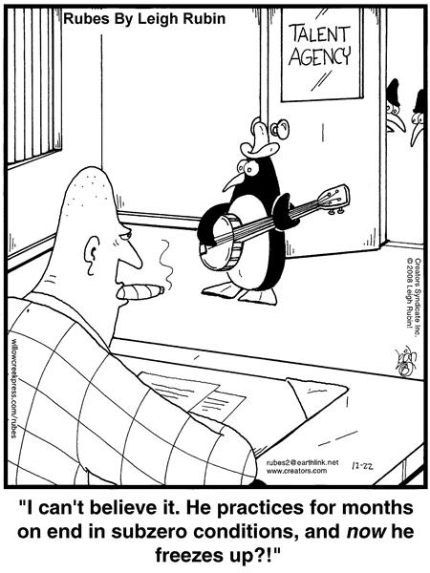
Talent Development
Some examples could include securing funding for a certification program, attending seminars provided by the University, etc.

Slide 22
Weighting and Rating

Slide 23
Weighting and Rating
For Institutional Goals, the total for all must equal 50%
Remember: “Supervision” is only applicable if the employee is a supervisor.

Slide 24
Weighting and Rating
3-5 Individual Goals are required. We recommend 3 for the first cycle on the new PM program.
The total for all Individual Goals must equal 50%

Slide 25
Weighting and Rate
One thing to remember about weights… They should not be changed at or near the end of a performance cycle unless due to significant extenuating circumstances.

Slide 26
Weighting and Rating
Scoring
Rate each Individual and Institutional Goal | Add all of the Scores together to assign a Final Overall Rating
1 = Not Meeting Expectations | 1.00 – 1.69 = Not Meeting Expectations
2 = Meeting Expectations | 1.70 - 2.69 = Meeting Expectations
3 = Exceeding Expectations | 2.70 - 3.00 = Exceeding Expectations
Multiply the Weight by the Rating to get the Score for each goal. Use two decimal places. (Example: 10% x 2 = .20)

Slide 27
Weighting and Rating
Weight x Rating = Score
Add all of the scores from Institutional Goals and Individual Goals to calculate Total Score.

Slide 28
Calibration Discussions

Slide 29
Calibration Overview
Discussions to set performance expectations and ratings fairly and consistently among similar positions.
Sessions held among peer supervisors in a supervisory team (all supervisors reporting to same manager)
Typically facilitated by the manager of the supervisory team

Slide 30
Calibration Overview
Value of Calibration
Helps supervisors set and apply similar standards
Helps identify and correct potential biases or errors
Encourages supervisors to think through expectations and ratings before giving them to employees
Ensures consistency among departmental units

Slide 31
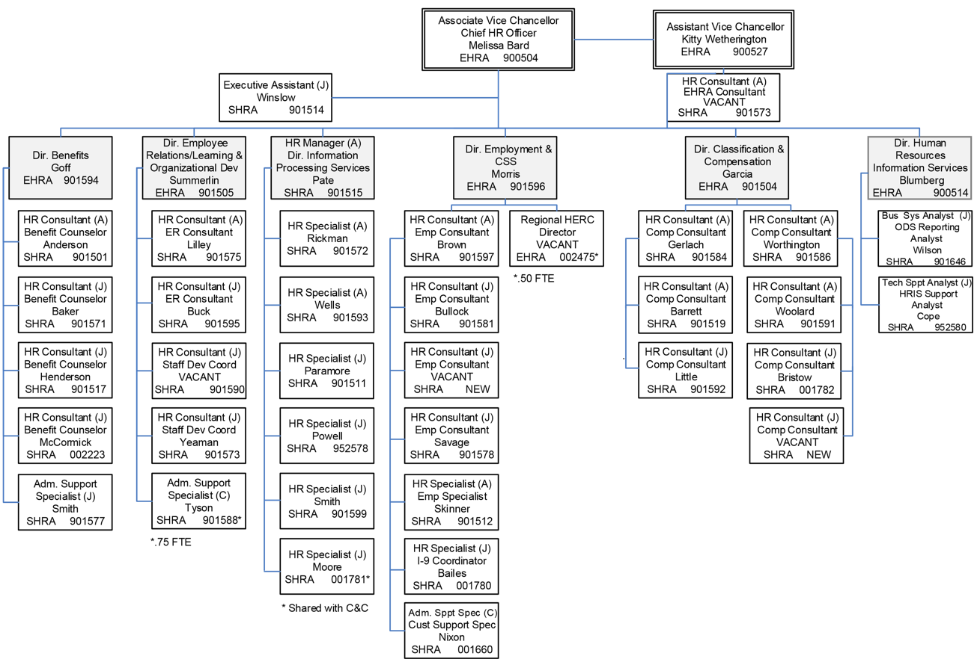

Slide 32
Calibration Overview
Two discussions required per cycle
Goal Calibration at the beginning of the performance cycle
Reviewing institutional goals to clarify expectations
Setting individual goals
Rating Calibration at the end of the performance cycle to ensure consistent, equitable, and fair assessments among similar positions.

Slide 33
Calibration Timeline
Both performance plans and annual appraisals need to be completed in the months of April and May
Typically supervisory teams should be meeting in mid-to-late April to hold calibration discussions for both the Annual Appraisal and the upcoming year’s Performance Plan.
These meetings are held before the supervisor can review the Annual Appraisal or the Performance Plan with the evaluated employee.

Slide 34
Goal Setting Calibration
Prework
Introduction
Similar Positions
Discuss Institutional Goals
Define Additional Resources
Define Individual Goals
Define Weights for Goals
Discuss Talent Development

Slide 35
Rating Calibration
Prework
Introduction
Discuss Institutional Goals
Discuss Individual Goals
Review Final Overall Ratings

Slide 36
Justin Yeaman
Christy Carraway
Learning and Organizational Development
252-328-9848
HRDevelopment@ecu.edu
Sara Lilley
Jeff Buck
Employee Relations
252-328-9848
Employeerelations@ecu.edu

